Slide 1
Backtracking

Slide 2
Contents
Basics
0/1 Knapsack
Max Clique
Travelling Salesperson Problem (TSP)

Slide 3
Basics
Solution space
Data structure used: Stack
Search Method: DFS

Slide 4
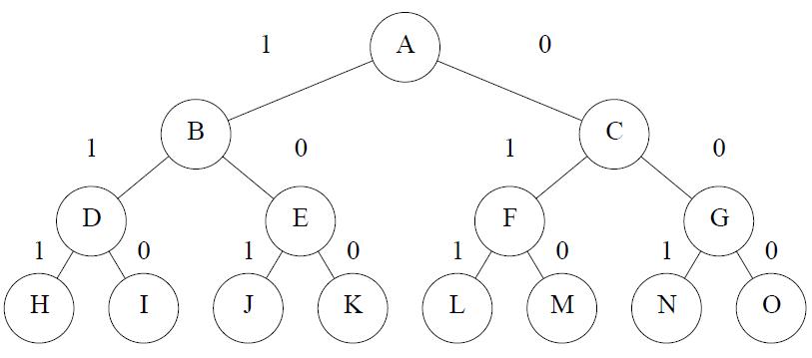
Solution space
To generate all the subset of 3 items

Slide 5
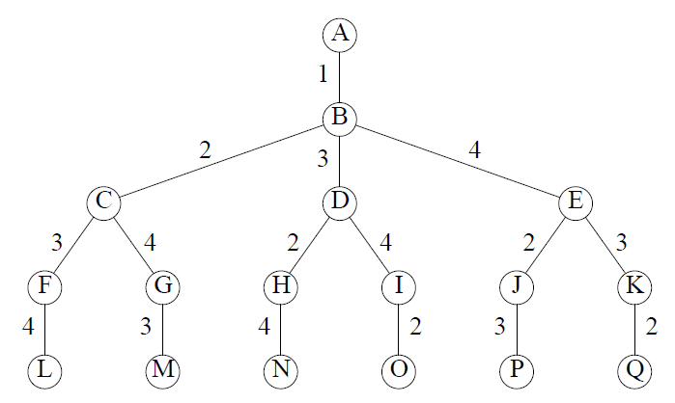
Solution space
All the permutation for 3 items

Slide 6
Solution space
p
q
r
s
t
u
v
w
x
y
z
a
b
c
d
e
C=7, P=[9,10,7,4], w=[3,5,2,1] Profit density=[3,2,3.5,4]
Bounding Function: At any node X (say), if current profit (cp) + remaining profit( r) <= Profit of best solution found so far , then no need to search the right subtree of x

Slide 7
C=7, P=[9,10,7,4], w=[3,5,2,1]
Profit/ density=[3, 2, 3.5, 4]
P=[4, 7, 9, 10] w=[1, 2, 3, 5]
0+19<20
7+10<20
16+0<20
p
r
s
t
u
w
x
y
z
a
b
c
d
e
q
v
A ->B->D -> H. From H we cant go to p, it exceed the capacity. A->B->D->H-> q, leaf node. Solution = [1, 1, 0, 1] Best Profit = 20. Back track to H, then H to D:
At D: cp+r=11+10=21>20 so search right subtree of D. Go to I. I to r we cant move since it exceed the capacity of the knapsack. At I: cp+r=11+0<20 no need to search right subtree. Back track to D then to B.
At B: cp+r=4+19=23>20 so search right subtree of B. B->E=>J, J to t exceed the capacity. At J: cp+r=13+0<20. Back track to E: at E:4+10 < 20 no need to search right subtree of E. Backtrack to B then to A. At A: 0 + 26 >20 search right subtree. And so on….

Slide 8
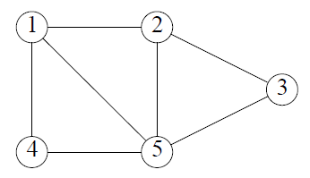
Max Clique
Clique
Max clique

Slide 9
3
1
p
q
r
s
t
u
v
w
x
y
z
a
b
c
d
e
Bounding Function: At any node X (say), if no. of nodes considered at current node (cn) + remaining nodes( r) <= number of nodes in the best solution found so far , then no need to search the right subtree of x

Slide 10
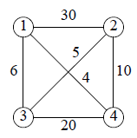
Traveling Salesperson Problem
Bounding function: If at node X (say), if cost of the partial tour built so far (cp) >= cost of best tour found so far, no need search further. Kill the node X.
A four vertex network
Solution space tree for a four vertex network

Slide 11
A -> B -> C -> F -> L, First solution: Best solution=12341 Best cost=59
Back track to F then to C, at C : cp =35 < 59 so go to G -> M another solution
12431, cost = 66 Best cost=59 . Back track to B, cp=0 <59, B to D , at D: cp=6 < 59 go to H, at H: cp=10<59 go to N. One more solution 13241, cost=25. Update Best cost=25.
Backtrack to H then to D, at D cp=6 < 25. Go to I, at I: cp=26 > 25 so kill node I. Bac track to D then backtrack to B at B also cp=0<25. So move to E. At E, cp=4< 25 move to J. At J : cp=14<25 go P one more solution: 14231 cost=25.
No need to update best cost.
Backtrack to J then to E, at E: cp < 25 go to K: at K: cp=24< 25 go to Q. One more solution 14321, cost = 50. No need to update Best cost.
Therefore, optimal solution is 13241 with cost =25.

Slide 12
Complexity
Worst case complexity of Backtracking algorithm for
0/1 Knapsack Problem O(2^{n})
Max clique Problem O(2^{n})
TSP : O((n-1)!)

